Slide 1
Gradient-Free Optimization of Starting Posture for Maximal Jump Height in a 3-Segment Planar Model
Dominik Zielinski
Richard and Loan HILL Department of biomedical engineering
BME 452 Final Project presentation

Slide 2
Motivation
Jumping performance is highly variable
Small differences in takeoff position directly determine how efficiently force converts to height.
Maximizing jump height is a gold-standard measure of lower-body power
Used in athletic assessment, rehabilitation, and prosthetic evaluation.
Finding the optimal starting posture requires many costly trials, and real human movement is inherently noisy
Joint angles cannot be reproduced exactly, so the choice of optimizer determines both how many attempts are needed and how robust the solution is to postural variability.

Slide 3
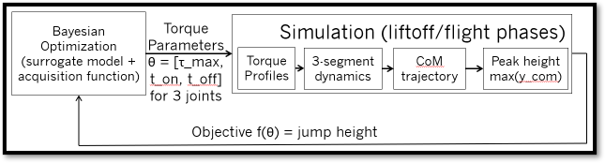
Methodology
Optimizer (BO, DE, CMA-ES)
Positional Parameters
θ= [θ₁, θ₂, θ₃] One angle per joint
Starting Position
Created simulation using 3 shank model
No gradient available; block-box ODE with discontinuous liftoff event
Torques given through step function at simulation start
Hip = 175 Nm & Knee = 247 Nm (Harbo et al. 2012)
Ankle = 175 Nm (Hussain & Frey-Law 2016)
Ground truth (GT) via high budget global search
Optimization:
Optimizers: Bayesian Optimization (BO), Differential Evolution (DE), Covariance Matrix Adaptation Evolution Strategy (CMA-ES)
Parameters: Initial Ankle [-0.6, 0.1], Knee [0.20, 1.80], and Hip [-2.20, -0.30] angles
Budget: 150 simulator calls per method
Noise: Clean, 0.025 radians, 0.05 radians

Slide 4
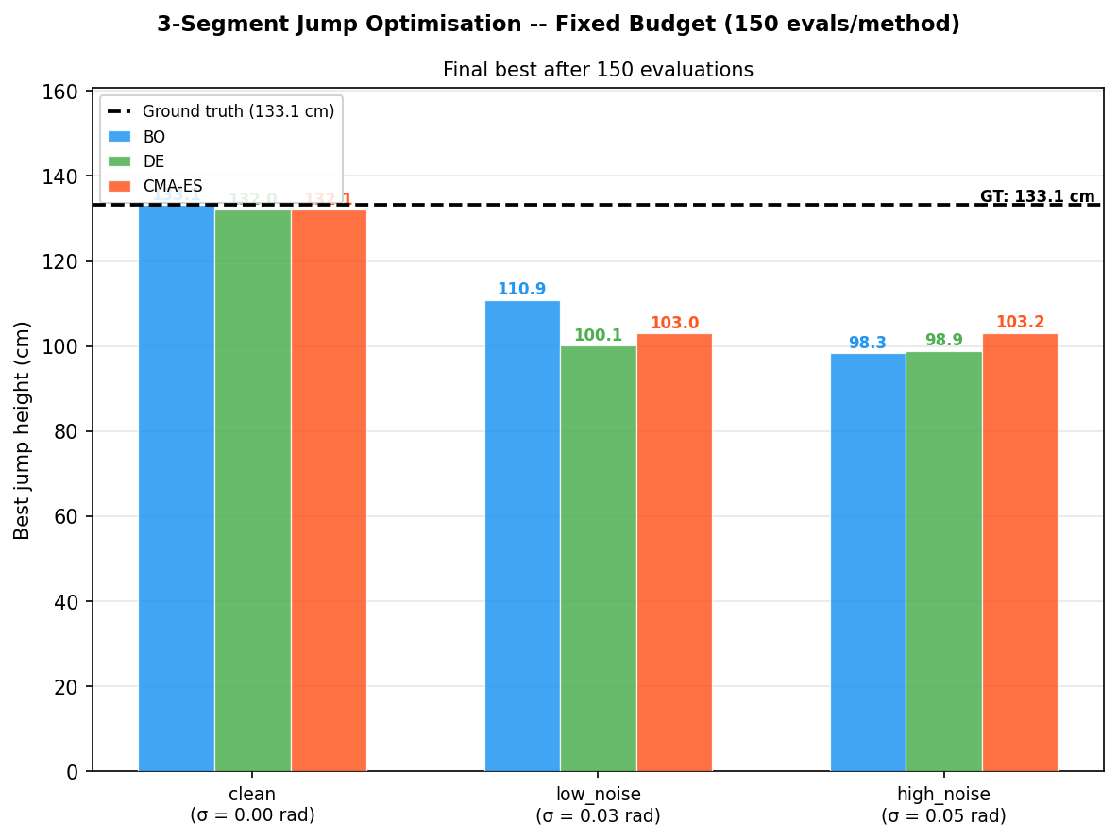
Comparison of optimized jump height

Slide 5
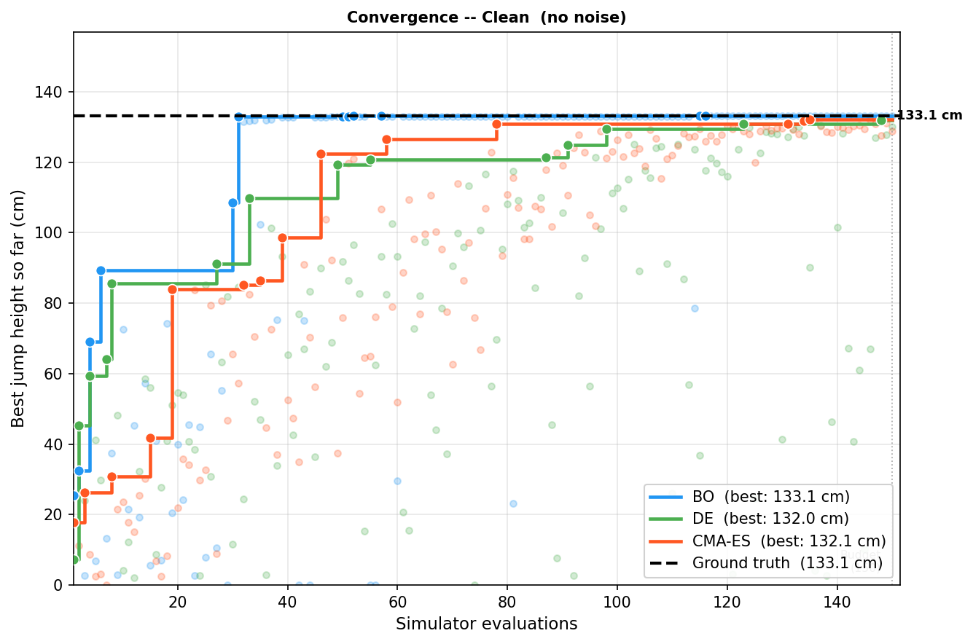
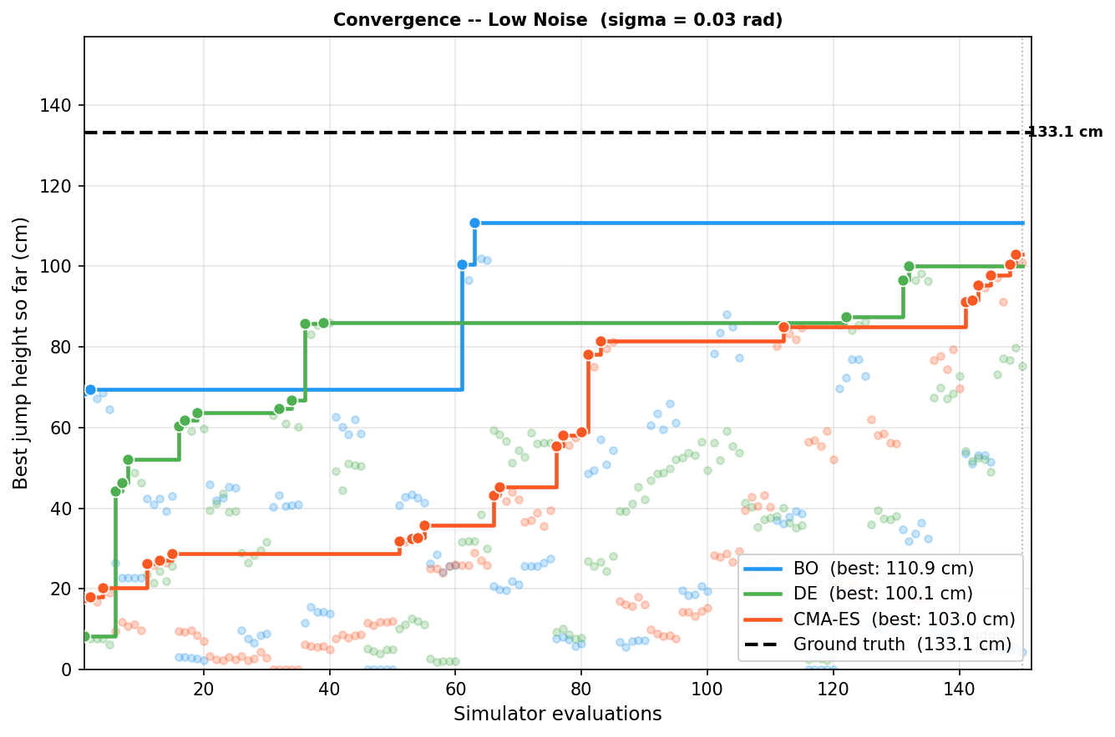
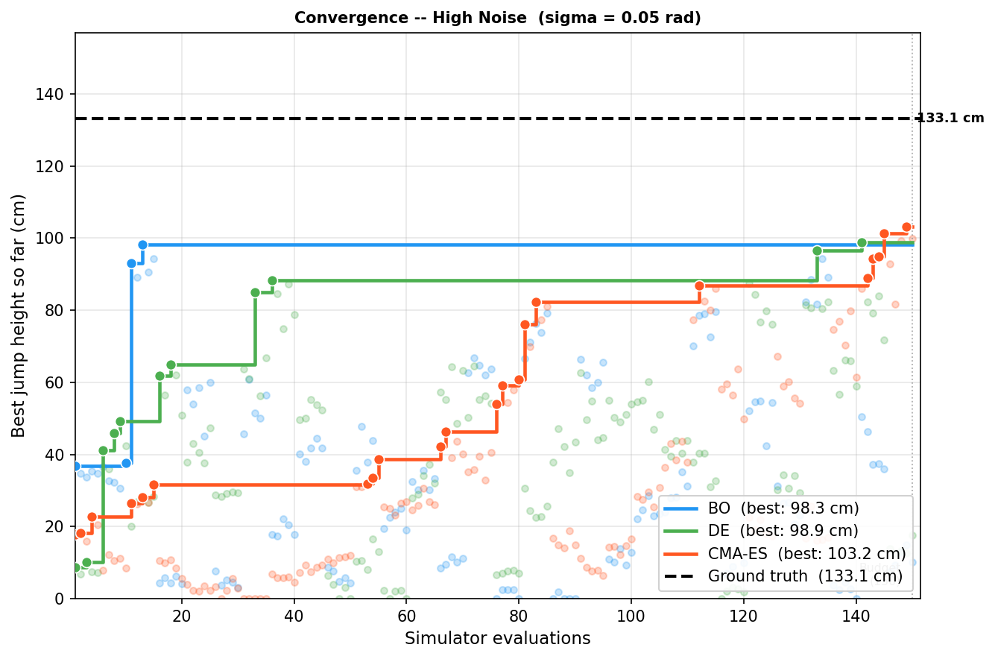
Optimizations at different noise levels

Slide 6
Key Takeaways
All 3 methods get within 1% of ground truth with 0 noise
Search space is well defined and solvable in 150 evaluations
Noise in starting position reduces jump height by 17-25%
Bayesian Optimization reaches near-optimal jump height with the fewest evaluations.
Sample efficiency makes it best suited for human trials, where each measurement is costly and posture is inherently variable.

